Slide 1

Predictive Coding for Locally
Linear Control
Rui Shu*, Tung Nguyen*, Yinlam Chow, Tuan Pham, Khoat Than, Mohammad Ghavamzadeh, Stefano Ermon, Hung Bui
SPEAKER:
Tung Nguyen – VinAI Resident

Slide 2
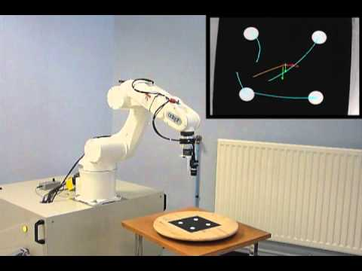
Motivation
Decision making from high-dimensional observations
Example: Robot arm manipulation from visual inputs
agent
observation
action
env

Slide 3
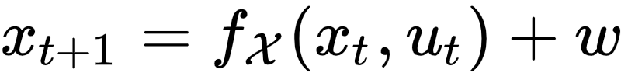
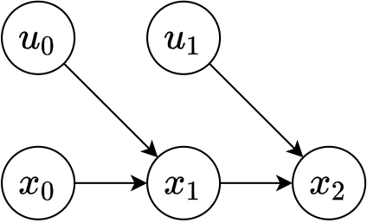
Problem Formulation
Control a high-dimensional Markov Decision Process

Slide 4
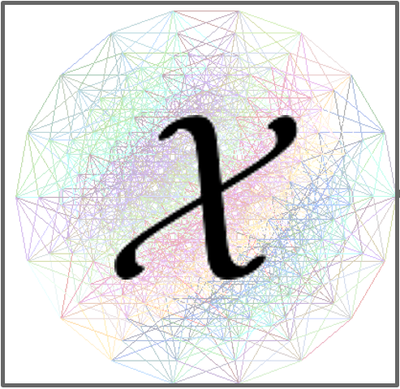

High-Dimensional Control is Challenging
Attempt optimal control in the observation space
Embed then control
Optimal control
Optimal control

Slide 5

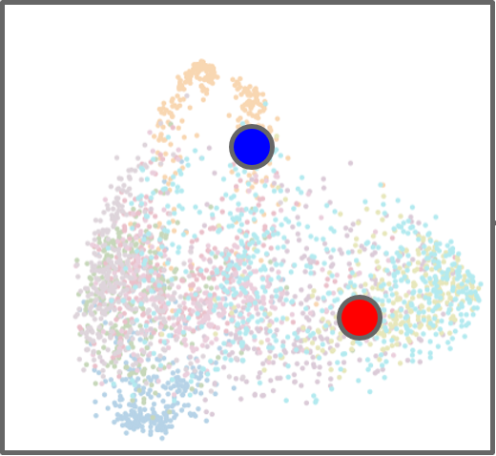
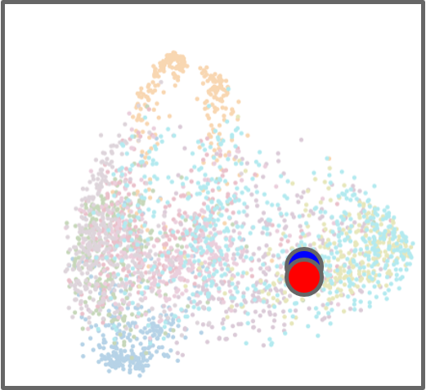



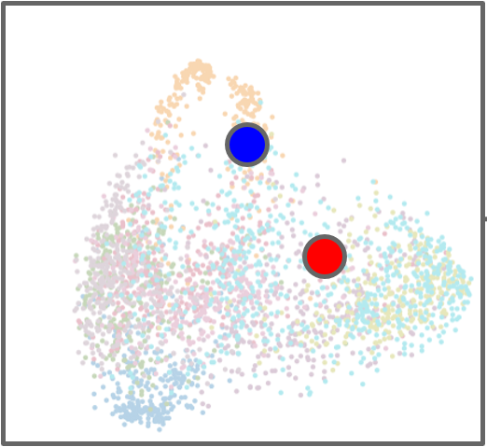
General approach
Learning Controllable Embedding (LCE): A two-step framework
Learn the embedding and latent dynamics
Control in the latent space

Slide 6

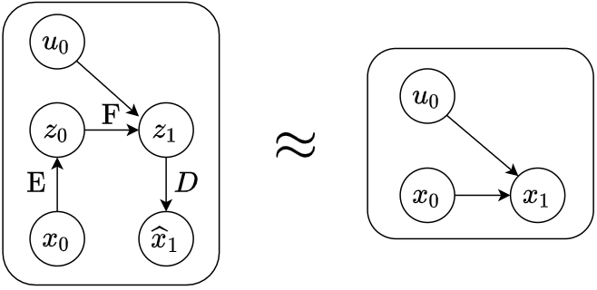
Existing LCE Models Use Explicit Prediction
Introduce an additional decoder and learns to predict the next observation
Latent Variable Model
True environment dynamics

Slide 7
Contributions
Propose a decoder-free LCE-based model
Provide theoretical analysis for the learned embedding
Conduct extensive experiments

Slide 8
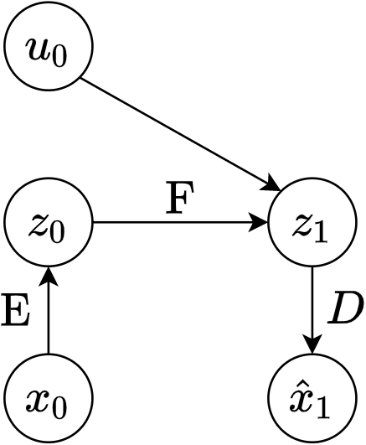
Learning an Embedding That is Good for Prediction
representation bottleneck
Decoder-based Directed Graph

Slide 9
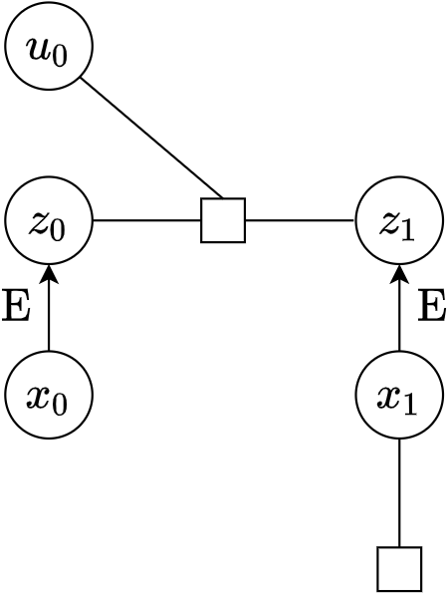
Learning an Embedding That is Good for Prediction
representation bottleneck
Predictive suboptimality of a representation:
The best possible prediction loss achievable by such this model family for a fixed choice of representation
Decoder-free Undirected Graph

Slide 10
Learning an Embedding That is Good for Prediction
Lemma 1: Predictive suboptimality is upper bounded by the mutual information gap:
Predictive suboptimality can be minimized in a decoder-free and information-theoretic manner
Information of
observation data
Information captured in latent space

Slide 11
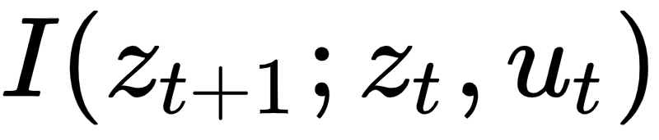
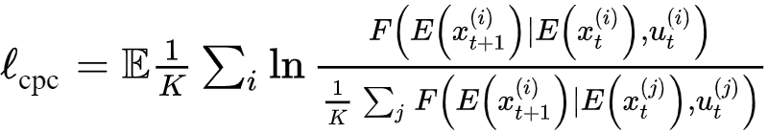
Learning an Embedding via Predictive Coding
Predictive coding maximizes a lower bound of
For a fixed choice of , if is the true latent dynamics, the CPC objective is maximized
critic

Slide 12
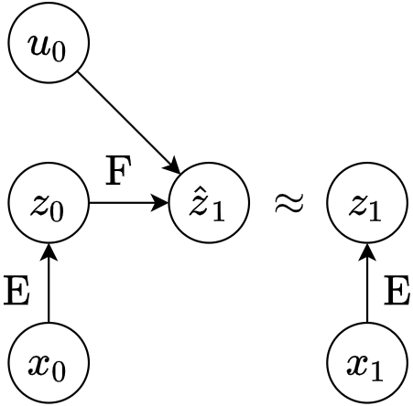
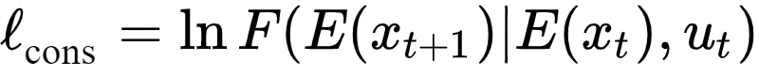
Estimating the Latent Dynamics via Consistency
Choosing to be the true latent dynamics maximizes the CPC objective
Choosing an that maximizes the CPC objective does not imply is the true latent dynamics model
Explicitly encourage to estimate the true latent dynamics via a consistency objective

Slide 13
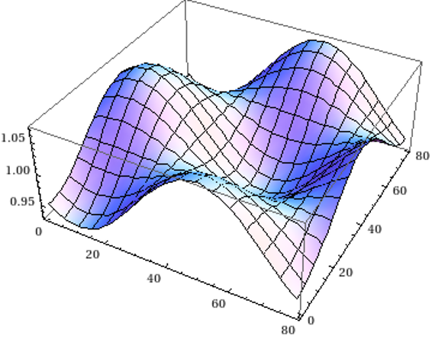
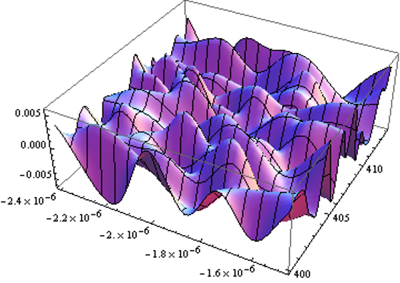
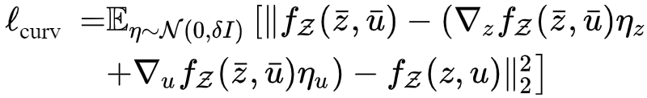
Enforcing Smooth Latent Dynamics via Curvature
We use locally-linear controllers (LLC), so a low-curvature dynamics is preferable

Slide 14
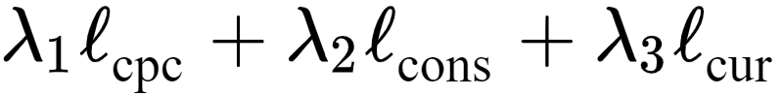
Predictive Coding, Consistency, Curvature (PC3)
Maximize CPC
Learn good embedding
Maximize Consistency
Learn good dynamics
Minimize curvature
is suitable for LLC

Slide 15
PCC vs PC3
Baseline
 | PC3 | PCC
Predictive Coding | ✔️ | ✖️
Prediction | ✖️ | ✔️
Consistency | ✔️ | ✔️
Curvature | ✔️ | ✔️
iLQR Controller | ✔️ | ✔️
PC3 is contrastive analog of PCC

Slide 16
PCC vs PC3
Control performance
Train 10 models, run 10 subtasks for each model (total 100 trials/method)
Task | PC3 (all) | PCC (all) | PC3 (top 1) | PCC (top 1)
Planar | 74.35 ± 0.76 | 56.6 ± 3.15 | 75.5 ± 0.32 | 75.5 ± 0.32
Balance | 99.12 ± 0.66 | 91.9 ± 1.72 | 100 ± 0 | 100 ± 0
Swing Up | 58.4 ± 3.53 | 26.41 ± 2.64 | 84 ± 0 | 66.9 ± 3.8
Cartpole | 96.26 ± 0.95 | 94.44 ± 1.34 | 97.8 ± 1.4 | 97.8 ± 1.4
3-link | 42.4 ± 3.23 | 14.17 ± 2.2 | 78 ± 1.04 | 45.8 ± 6.4

Slide 17
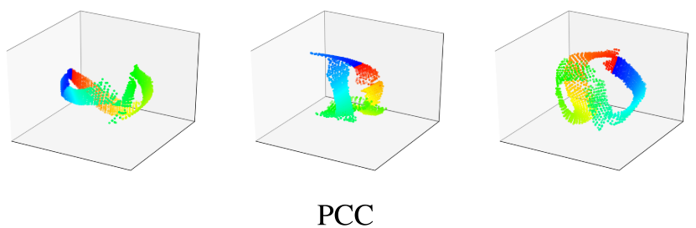
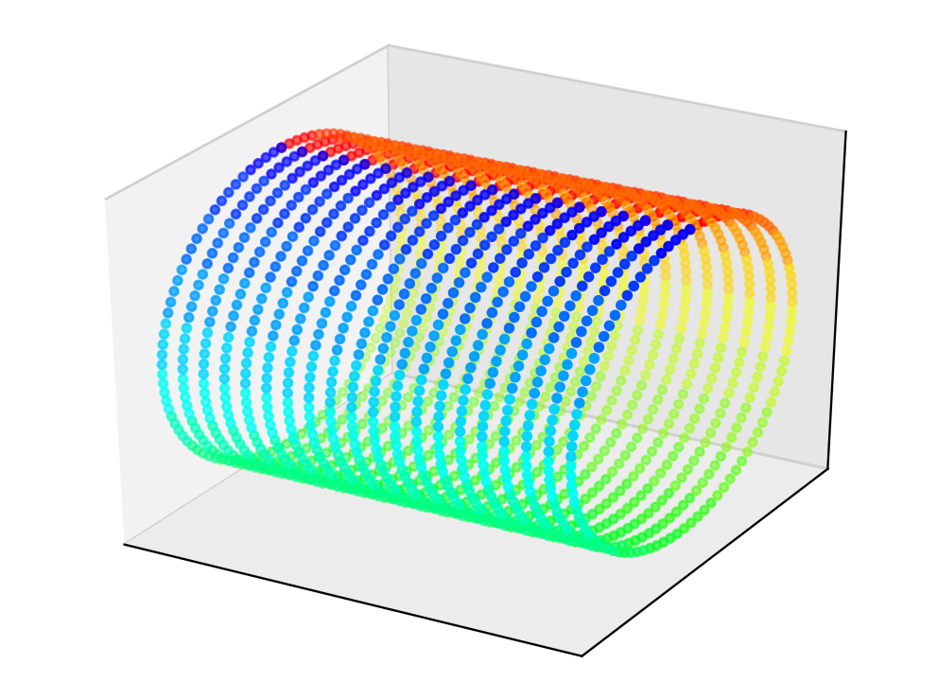
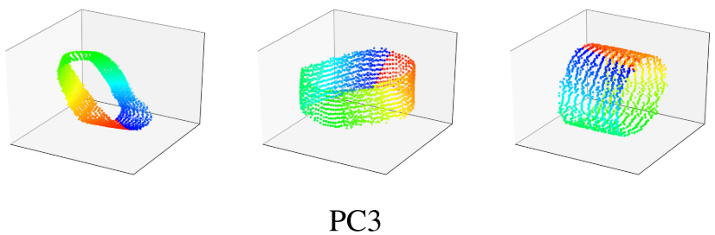
PCC vs PC3
Latent maps
True state space

Slide 18
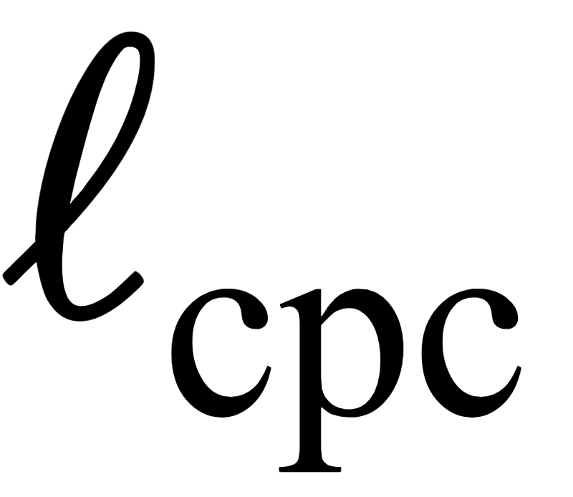


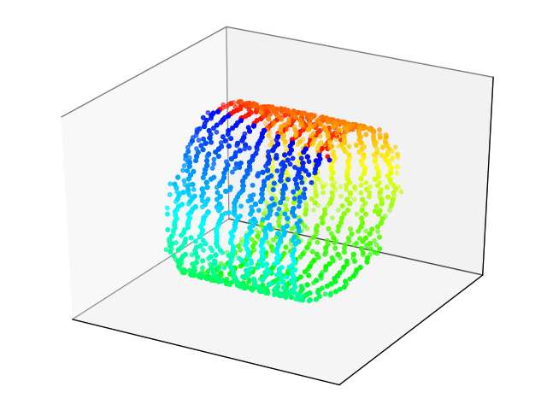
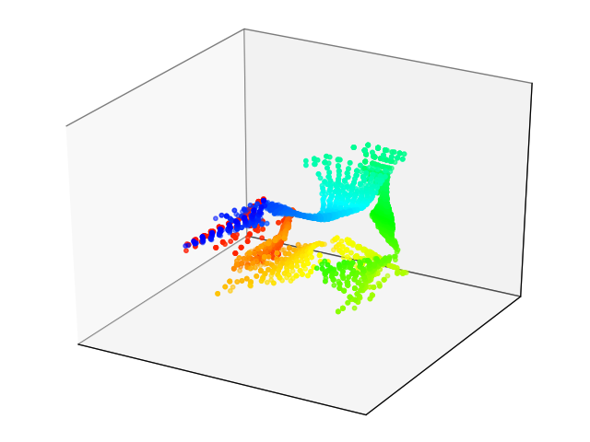
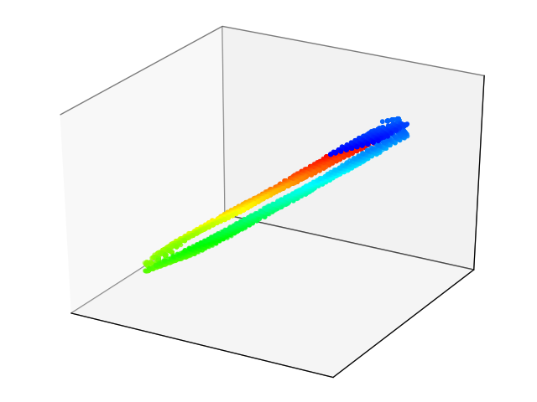
Ablation Analysis
Setting |  |  |  | Control
PC3 | 4.58 | 2.13 | 0.03 | 58.4 ± 3.53
w/o | 5.03 | -4.87 | 0.0025 | 7.46 ± 1.32
w/o | 4.8 | 2.34 | 0.56 | 21.69 ± 2.73
PC3
Without
Without

Slide 19
Ablation Analysis
Setting |  |  |  | Control
PC3 | 4.58 | 2.13 | 0.03 | 58.4 ± 3.53
w/o | 5.03 | -4.87 | 0.0025 | 7.46 ± 1.32
w/o | 4.8 | 2.34 | 0.56 | 21.69 ± 2.73
PC3
Without
Without

Slide 20
Conclusion
Predictive Coding-Consistency-Curvature (PC3) outperforms existing LCE-based models
Promising information-theoretic extension of the LCE framework
Future work
Scale to more complicated domains
Predictive coding in conjunction with other control algorithms

Slide 21

Thank you for listening!
Paper Link

Slide 22

www.vinai.io

